Slide 1
Loops

Slide 2

Introduction to Loops
Notes:
This presentation demonstrates the new capabilities of PowerPoint and it is best viewed in Slide Show. These slides are designed to give you great ideas for the presentations you’ll create in PowerPoint 2010!
For more sample templates, click the File tab, and then on the New tab, click Sample Templates.

Slide 3
1. Through this lecture, students will learn the concept of looping in C
2. Students will understand the different types of statements encountered in C
Learning
Outcomes

Slide 4
Contents
Control Statements
Flow of construct
Loops : if-else, switch-case

Slide 5
Control Statements

Slide 6
Control Flow
Flow Control
Decisions are based on boolean expressions
Making program behave in particular manner depending on input
Used when we want program to intelligently do what we want
Order of statement execution is flow control

Slide 7
Control Flow statements
Conditional
statements
Unconditional
statements
Decision making control
Iterative control
Jumping / skipping
statements
If
If-else
Else-if ladder
Switch-case
Do-while
While
For
goto
break
continue

Slide 8


Slide 9

Concept of If statement

Slide 10

Concept of If-else statement

Slide 11

Concept of Nested If statement

Slide 12
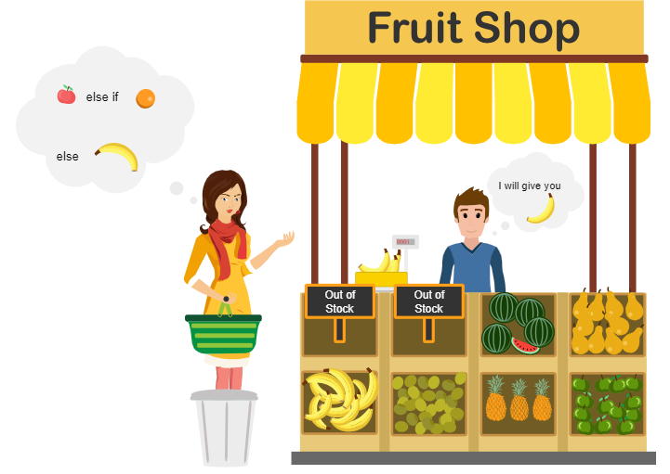
Concept of Nested else-if statement

Slide 13
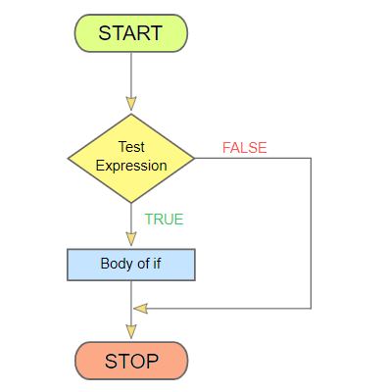
Logic of an if statement

Slide 14
Syntax of an if statement
The condition must be a
boolean expression. It must
evaluate to either true or false.
if is a C
reserved word
if ( condition )
statement;
If the condition is true, the statement is executed.
If it is false, the statement is skipped.

Slide 15
Commonly used in scenarios:
Is A bigger than B?
Is X equal to Y?
Is M not equal to N?
Arduino microcontroller make use of C programming, where you need to blink a warning light(red light) when certain condition met.
for example:
if(x = 123)
digitalWrite(LEDpin, high)
Uses of an If statement

Slide 16
Simple If statement C program
# include <stdio.h> //header file section
#include <conio.h>
int main()
{
int age = 18;
if(age > 17)
{ printf("you are eligible for voting "); }
printf("\nThis is normal flow ");
return 0;
}

Slide 17
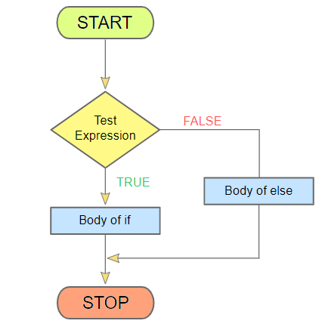
Logic of an if-else statement

Slide 18
Syntax of an if-else Statement
An else clause can be added to an if statement to make an if-else statement
if ( condition )
statement1;
else
statement2;
If the condition is true, statement1 is executed; if the condition is false, statement2 is executed
One or the other will be executed, but not both

Slide 19
Arduino microcontroller make use C programming, where you can alarm if your sensors output in greater than or lesser than expected value, else blink green light always.
for example:
if(x = 123)
digitalWrite(LEDpin,high)
else
digitalWrite(LEDpin,low)
Uses of an If-else statement

Slide 20
If-else statement C program
#include <stdio.h> //header file section
int main()
{
int age;
printf("Enter your age : ");
scanf("%d",&age);
if(age > 17)
{ printf("\nyou are eligible for voting "); }
else
{ printf("\nSorry, you are not eligible for voting "); }
printf("\nThis is normal flow ");
return 0;
}

Slide 21
Conditional operator
The conditional operator (? :) also makes use of an expression that is either true or false. This is equivalent to a simple if- else structure.
Example:
Suppose status is a char-type variable and balance is a floating-point variable.
We wish to assign the character C (current) to status if balance has a value of zero, and 0 (overdue) if balance has a value that is greater than zero.
Statement in C:
status = (balance == 0) ? 'C' : '0'

Slide 22
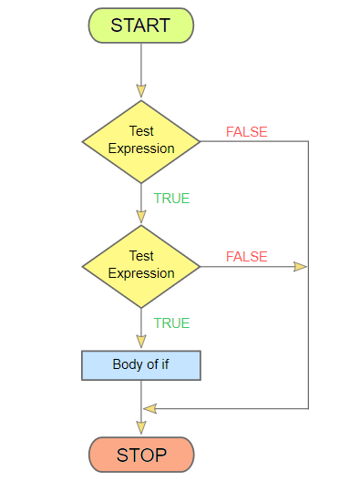
Logic of nested if statement

Slide 23
Syntax of nested if Statement
if(condition)
{
if(condition)
{
here goes statements;
}
}
In nested if statements, we can write one within another.
If outer if statement fails, then the compiler skips the entire block irrespective of their inner if statement.

Slide 24
Nested-If statement C program
#include <stdio.h> //header file section
int main()
{
int a = 47, b = 25, c = 3;
if (a > b)
{
if (a > c)
{
printf("The value a is greater than b and c "); }
}
printf("\nThis is normal flow ");
return 0;
}

Slide 25
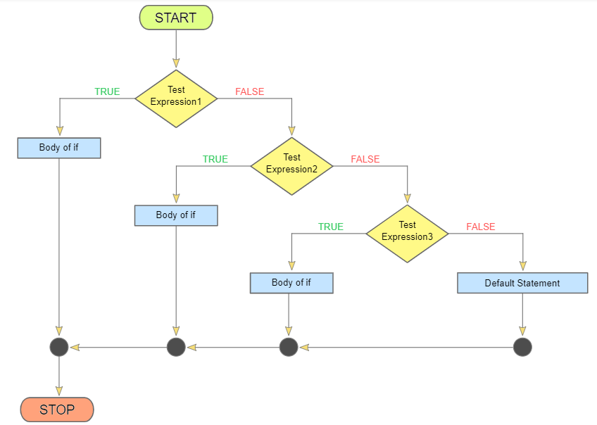
Logic of nested else if statement

Slide 26
Syntax of nested else if Statement
if(test_expression 1)
{
here goes statements;
}
else if(test_expression 2)
{ here goes statements;
}
else { here goes statements; }
In nested else if statement, the number of logical conditions can be checked for executing various statements.
If any logical condition is true the compiler executes the block under that else if condition, otherwise, it skips and executes else block.
By default else block will be executed, if all the remaining conditions are false.

Slide 27
Nested Else-If statement C program
#include <stdio.h> //header file section
int main()
{
int a;
printf("Enter a number: ");
scanf ("%d ", &a);
if(a > 0)
{ printf("\n%d is a positive number", a); }
else if(a < 0)
{ printf("\n%d is a negative number", a); }
else
{ printf("\n%d is a zero",a); }
return 0;
}

Slide 28
Boolean Expressions
A condition : uses one of C's equality operators or relational operators, which all return boolean results:
== equal to
!= not equal to
< less than
> greater than
<= less than or equal to
>= greater than or equal to
equality operator (==) and the assignment operator (=)

Slide 29
Block Statements
Several statements can be grouped together into a block statement delimited by braces
A block statement can be used wherever a statement is called. In an if-else statement, the if portion, or the else portion, or both, could be block statements
if (total > MAX)
{
printf("Error!!");
errorCount++;
}
else
{
printf ("Total: %d“, total);
current = total*2;
}
if (total > MAX)
{
printf ("Error!!\n");
errorCount++;
}

Slide 30
While purchasing certain items, a discount of 10% is offered if the quantity purchased is more than 1000. If quantity and price per item are input through the keyboard, write a program to calculate the total expenses.
The marks obtained by a student in 5 different subjects are input through the keyboard. The student gets a division as per the following rules: Percentage above or equal to 60 - First division Percentage between 50 and 59 - Second division Percentage between 40 and 49 - Third division Percentage less than 40 - Fail Write a program to calculate the division obtained by the student.
Write a program to check whether a triangle is valid or not, when the three angles of the triangle are entered through the keyboard. A triangle is valid if the sum of all the three angles is equal to 180 degrees.
Implement following C programs using
if, else-if, nested if statements

Slide 31
Switch Statement
select from multiple choices
alternative to if-else-if statement
four important elements: test expression, case , break and default statements
matches the result to one of several possible cases
break statement causes control to transfer to the end of the switch statement.
with optional default case, control will transfer to it if no other case value matches
expression must result in an integral type, cannot be a floating point value (float or double)

Slide 32
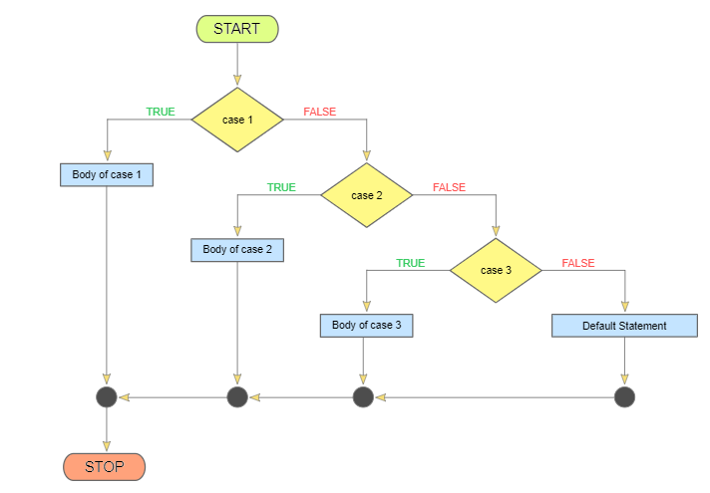
Syntax of switch statement

Slide 33
Syntax of switch Statement
switch
and
case
are
reserved
words
switch ( expression )
{
case value1 :
statement-list1
case value2 :
statement-list2
case value3 :
statement-list3
case ...
}
If expression
matches value2,
control jumps
to here

Slide 34
Program using switch statement to greet either dad or mom or yourself
#include <stdio.h>
int main()
{ int choice;
printf("Press 1 to greet your dad\n ");
printf("Press 2 to greet your mom\n ");
printf("Press 3 to greet yourself\n ");
scanf("%d ",&choice);
switch (choice)
{ case 1: printf("\nHello dad,How are you? ");
break;
case 2: printf("\nHello mom,How are you? ");
break;
case 3: printf("\nHello awesome,How are you? ");
break;
default: printf("\nInvalid choice ");
} return 0;}

Slide 35
Make a simple calculator using switch case statement. Operators are (*,+,-,/)
Read weekday number and print weekday name using switch.
Check whether a character is VOWEL or CONSONANT using switch.
Implement C programs using switch case statements

Slide 36
Quiz

Slide 37
What will be the output of the C program?
#include<stdio.h>
int main()
{ char num = '\010';
printf("%d", num);
return 0;
}
A. 010 B. 08 C. 10 D. 8

Slide 38
2. #include<stdio.h>
#define FALSE -1
#define NULL 0
#define TRUE 1
int main()
{ if(NULL)
printf("NULL");
else if(FALSE)
printf("TRUE");
else
printf("FALSE");
return 0;
}
FALSE B. NULL C. TRUE D. COMPILATION ERROR

Slide 39
3. #include<stdio.h>
int main()
{ int i = 0;
while(i < 2)
switch(i)
{ i = 2;
case 0: printf("Hai. This is case 0");
i++;
case 1: printf("Hai. This is case 1");
i++; break;
case 2: printf("Hai. This is case 2");
i++; break;
default: printf("Hai. This is default");
i++; break;
}
return 0;
}
A. Hai. This is case 0 Hai. This is case 1
B. Hai. This is case 0 Hai. This is case 2
C. Hai. This is case 0 Hai. This is case 1 Hai. This is case 2
D. Hai. This is case 0 Hai. This is default

Slide 40
4. #include<stdio.h>
#define N 1.5
int main()
{ int i = 6;
switch(i)
{ case N + 5: printf("Switch ON the fan"); break;
case N * 4: printf("Switch ON the Air Cooler"); break;
default: printf("Save Energy");
}
return 0; }
A. Switch ON the fan B. Switch ON the Air Cooler C. Save Energy
D. Compilation Error

Slide 41
Thank You......

